Slide 1
Gov 1780: International Political Economy
Section 8
18 Mar 2021

Slide 2
Agenda
Exam information
Today we are going to walk through the fundamentals of how exchange rates and balance of payments work.
Breakout rooms: answering your biggest questions.

Slide 3
Exam information
Midterm exam will be open from April 1st, 9am EST - April 4th, 9am EST
Final exam will be open from May 6th, 9am EST - May 9th, 9am EST
90 minute timed exam to be opened and then submitted on Canvas
Choose eight terms from a list, define them, and explain their relevance to International Political Economy (two paragraph responses per term, approximately)

Slide 4




Exchange rates, explained.
The United States has a comparative advantage in producing oil. Spain has a comparative advantage in producing olive oil.

Slide 5
Exchange rates, explained.
With demand for foreign goods comes demand for foreign currency. Spain demands $s to buy oil. U.S. demands € to buy olive oil.

Slide 6
Exchange rates, explained.
1$ = .84€
In a fixed exchange-rate system, what should we expect to happen to this exchange rate?

Slide 7
Exchange rates, explained.
1$ = .84€
It should remain the same: one currency is 'pegged' to the value of another. Many countries currently operate with fixed exchange rates, 'pegged' to another currency.

Slide 8
Exchange rates, explained.
1$ = .84€
In a floating exchange-rate system, what should we expect to happen to this exchange rate?

Slide 9
Exchange rates, explained.
1$ = .84€
The exchange rate will fluctuate based on supply and demand for each currency. Some floating currencies include the U.S. dollar, euro, and the Japanese yen.

Slide 10



Exchange rates, explained.
€
€
€
€
If demand for the Euro is high, then Euros become more expensive to obtain relative to other currencies.

Slide 11
Exchange rates, explained.
€
€
€
€
What might increase demand for Euros relative to other currencies?

Slide 12
Exchange rates, explained.
€
€
€
€
Relatively higher interest rates set by the European Central Bank (ECB), extremely high demand for Spanish goods, or ECB intervention.

Slide 13
Exchange rates, explained.
Government intervention to increase exchange rates might include selling bonds or buying one's own currency to reduce supply.
The latter policy option - intervening in foreign exchange markets to influence currency supply - can be pursued on a managed float system.
Notes:
The European Bank states: "In the absence of any formal agreements or general guidelines, the Eurosystem may decide, where necessary, to conduct foreign exchange interventions. The Eurosystem may conduct such interventions either on its own (i.e. unilaterally) or as part of a coordinated intervention involving other central banks (i.e. concerted action)."

Slide 14
Exchange rates, explained.
Even the ECB leaves this option available to exercise when necessary:
"In the absence of any formal agreements or general guidelines, the Eurosystem may decide, where necessary, to conduct foreign exchange interventions. The Eurosystem may conduct such interventions either on its own (i.e. unilaterally) or as part of a coordinated intervention involving other central banks (i.e. concerted action)."
European Central Bank

Slide 15
Balance of payments, explained.
Now that we have a better idea about how exchange rates work, let's move on to balance of payments.
For those of you interested in doing a DEEP dive on definitions and accounting, see this link for extremely thorough guidance provided by the IMF.

Slide 16
Balance of payments, explained.
Current account
???
Let's now use the United States as an example.
What kinds of transactions are recorded in the current account?

Slide 17
Balance of payments, explained.
Current account
Trade in goods
Imports
Exports
Trade in services
Imports
Exports
Primary income
receipts
payments
Secondary income
receipts
payments
Non-financial transactions between a country and the rest of the world. These include trade in goods, services, primary income, and secondary income.

Slide 18
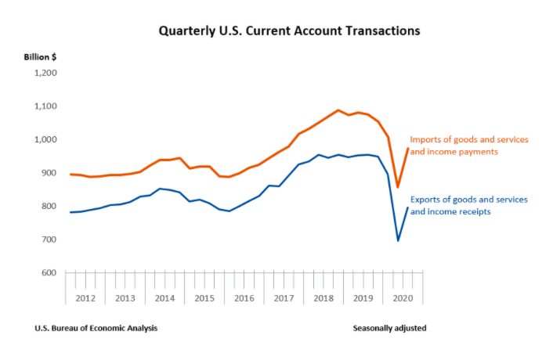
Balance of payments, explained.
Here's a practical example drawing directly from U.S. Bureau of Economic Analysis data.

Slide 19
Balance of payments, explained.
Current account
Financial account
Trade in goods
Imports
Exports
Trade in services
Imports
Exports
Primary income
receipts
payments
Secondary income
receipts
payments
??
-
+
-
+
What kinds of transactions are recorded in the financial account?

Slide 20
Balance of payments, explained.
Current account
Financial account
Capital account
Trade in goods
Imports
Exports
Trade in services
Imports
Exports
Primary income
receipts
payments
Secondary income
receipts
payments
Acquisition of financial assets
direct investment assets
portfolio assets
other assets
Incurrence of liabilities
direct investment liabilities
portfolio liabilities
other liabilities
-
+
-
+
Capital flows between the U.S. and the rest of the world. These include the purchases of foreign assets (acquisition or capital outflow) and foreign purchases of Spanish assets (liability or capital inflow).

Slide 21
Balance of payments, explained.
Current account
Financial account
Capital account
Trade in goods
Imports
Exports
Trade in services
Imports
Exports
Primary income
receipts
payments
Secondary income
receipts
payments
Acquisition of foreign assets
direct investment assets
portfolio assets
other assets
Foreign acquisition of U.S. assets
direct investment assets
portfolio assets
other assets
-
+
-
-
+
+
Capital outflows, which occur when foreign assets are acquired, register as negative. Capital inflows, which occur when U.S. assets are acquired by foreigners, register as positive.

Slide 22
Balance of payments, explained.
Current account
Financial account
Capital account
Trade in goods
Imports
Exports
Trade in services
Imports
Exports
Primary income
receipts
payments
Secondary income
receipts
payments
Acquisition of foreign assets
direct investment assets
portfolio assets
other assets
Foreign acquisition of U.S. assets
direct investment assets
portfolio assets
other assets
-
+
-
-
+
+
What is the difference between the financial account and the capital account?

Slide 23
Balance of payments, explained.
Current account
Financial account
Capital account
Trade in goods
Imports
Exports
Trade in services
Imports
Exports
Primary income
receipts
payments
Secondary income
receipts
payments
Acquisition of foreign assets
direct investment assets
portfolio assets
other assets
Foreign acquisition of U.S. assets
direct investment assets
portfolio assets
other assets
Capital transfers
Debt forgiveness
other transfers
(eg. migrants' transfers)
Acquisition/
disposal of nonproduced, nonfinancial assets
trademarks
leases
goodwill
-
+
-
-
+
+
While the financial account handles capital inflows and outflows related to asset acquisitions, the capital account primarily reflects transfers in which the ownership of an asset (other than cash or inventories) changes from one party to another.

Slide 24
Balance of payments, explained.
Current account
Financial account
Capital account
Trade in goods
Imports
Exports
Trade in services
Imports
Exports
Primary income
receipts
payments
Secondary income
receipts
payments
Acquisition of foreign assets
direct investment assets
portfolio assets
other assets
Foreign acquisition of U.S. assets
direct investment assets
portfolio assets
other assets
Capital transfers
Debt forgiveness
other transfers
(eg. migrants' transfers)
Acquisition/
disposal of nonproduced, nonfinancial assets
trademarks
leases
goodwill
-
+
-
-
+
+
+
+
Current account balance + Capital account balance + financial account balance = balance of payments

Slide 25
Balance of payments, explained.
Current account
Financial account
Capital account
Trade in goods
Imports
Exports
Trade in services
Imports
Exports
Primary income
receipts
payments
Secondary income
receipts
payments
Acquisition of foreign assets
direct investment assets
portfolio assets
other assets
Foreign acquisition of U.S. assets
direct investment assets
portfolio assets
other assets
Capital transfers
Debt forgiveness
other transfers
(eg. migrants' transfers)
Acquisition/
disposal of nonproduced, nonfinancial assets
trademarks
leases
goodwill
-
+
-
-
+
+
+
+
Many sources (other than the IMF) refer to the financial and capital account together as the capital account.

Slide 26
There is still so much left to cover.
What is the relationship between inflation and exchange rates?
Is there a relationship between a trade deficit and a national budget deficit?
How does the Policy Trilemma actually work?
etc.

Slide 27
Breakout room activity
Take one minute to consider and write down the biggest question you still have.
In breakout rooms, you will split off into pairs.
Share your big question with your partner.
Each person should create a slide in this deck with one's specific question as the title. Write your name in the bottom right-hand corner of the slide.
Use the class readings, credible online resources (IMF, governmental websites, etc.), and each other to tackle that question.
Present the answer on your respective slide as clearly as concisely as possible. Feel free to utilize graphs or diagrams!

Slide 28
Question 1

Slide 29
Question 2

Slide 30
Question 3

Slide 31
Question 4

Slide 32
Question 5

Slide 33
Question 6

Slide 34
Question 7

